Slide 1
MLP 2022-2 by Y.K.Kim 2022.07.28
Luminar Iris LiDAR
한동대학교 기계제어공학부
21600502 SeongJu Lee
21700421 ChangMin An

Slide 2
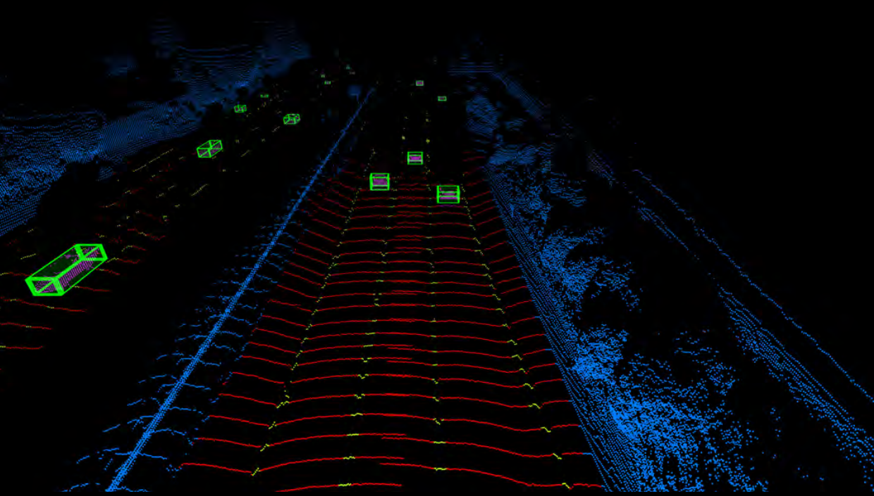

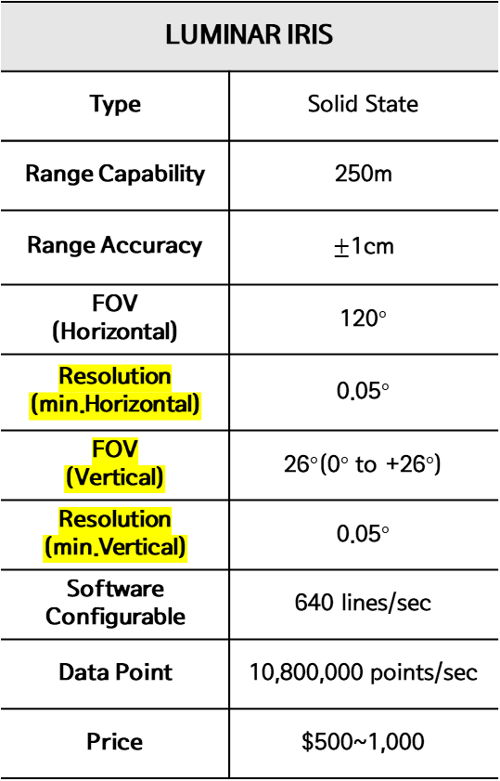
Specification
LUMINAR IRIS
Type | Solid State
Range Capability | 250m
Range Accuracy | $±$1cm
FOV (Horizontal) | 120$°$
Resolution (min.Horizontal) | 0.05$°$
FOV (Vertical) | 26$°$(0$°$ to +26$°$)
Resolution (min.Vertical) | 0.05$°$
Software Configurable | 640 lines/sec
Data Point | 10,800,000 points/sec
Price | $500~1,000

